Slide 1
Spring cloud
Wang ShuGuang (William)

Slide 2
agenda
Purpuse
Overview
Key Components
Summary
Demo
Practice

Slide 3
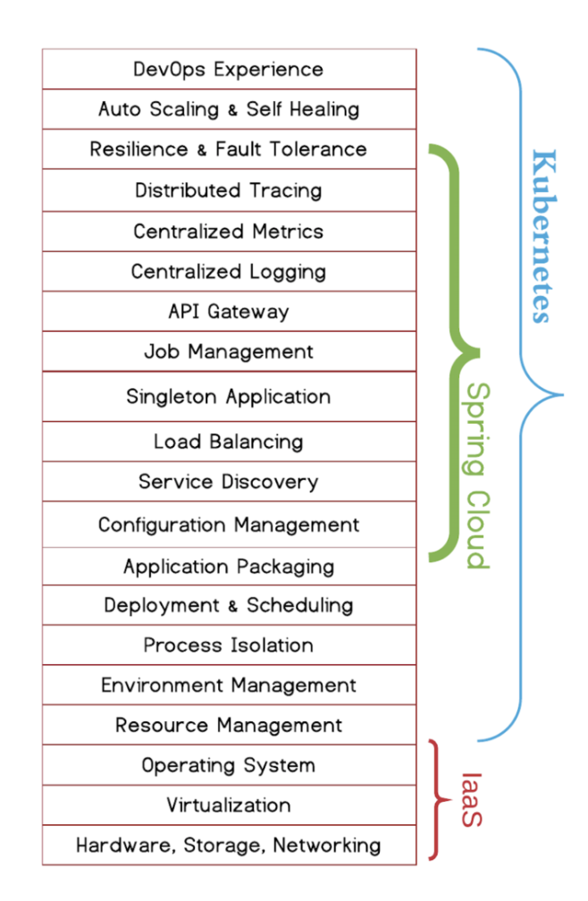
Overview
Spring Cloud : Easy to deploy on cloud environment with Docker, k8s etc.
Spring boot based library set for building the micro service.

Slide 4
Purpose
Basic understanding for spring cloud .
Build a simple micro service with spring cloud.

Slide 5
Key components
Components | Products
Configuration | Spring Cloud Config + Spring cloud Bus
Registration and Discovery | Netflix Eureka Consul
Gateway | Netflix Zuul Spring Cloud gateway
Service to Service calls | Feign
Load balancing | Netflix Ribbon
Circuit breakers | Netflix Hystrix + Turbine
Distributed messaging | Spring Cloud stream
Trace | Spring Cloud Sleuth
Spring
Cloud Netflix
Notes:
Netflix Eureka allows micro services to register themselves at runtime as they appear in the system landscape
Netflix Ribbon -Dynamic Routing & Load Balancer
Netflix Ribbon can be used by service consumers to look up services at runtime. Ribbon uses the information available in Eureka to locate
appropriate service instances. If more than one instance is found, Ribbon will apply load balancing to spread the requests over the available instances. Netflix Zuul -Edge Server Zuul is the entry point to the microservices in the system landscape. Using dynamically allocated ports is convenient to avoid port conflicts and to minimize administration but it makes it of course harder for any given service consumer. Zuul uses Ribbon to look up available services and routes the external request to an appropriate service instance.

Slide 6
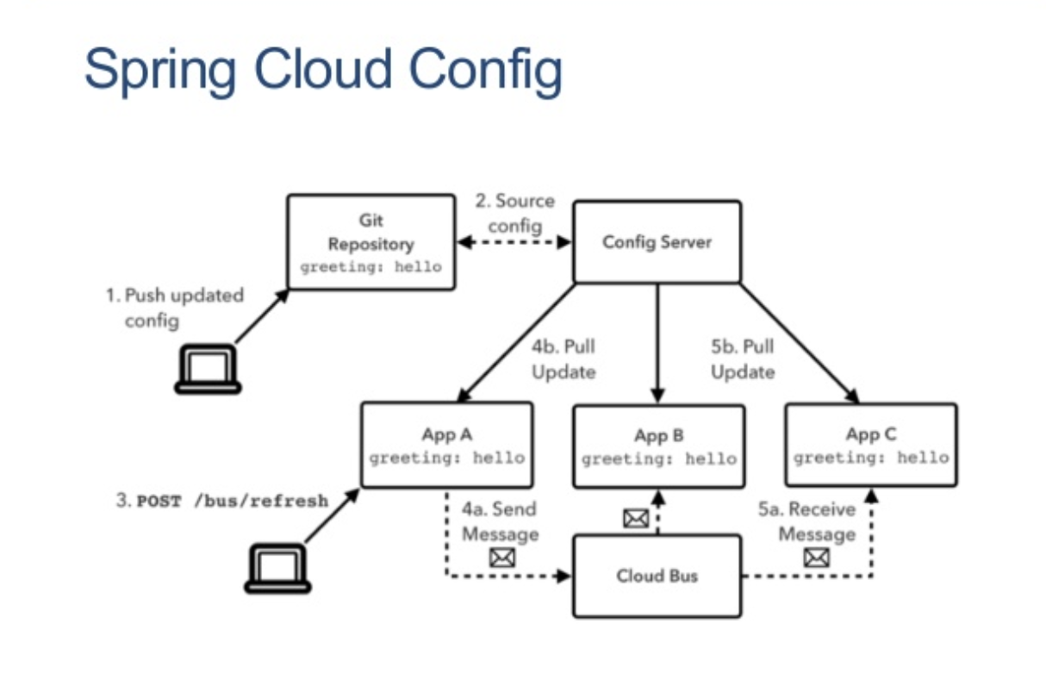
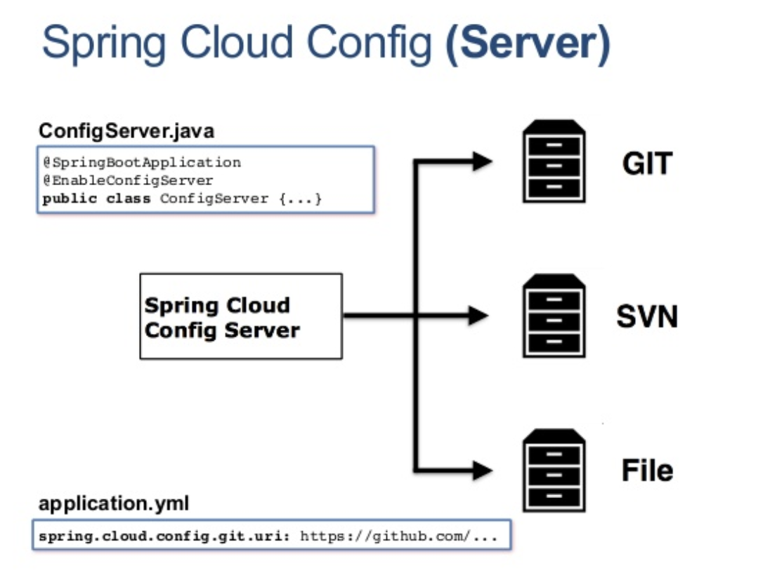
Config center — spring cloud config

Slide 7
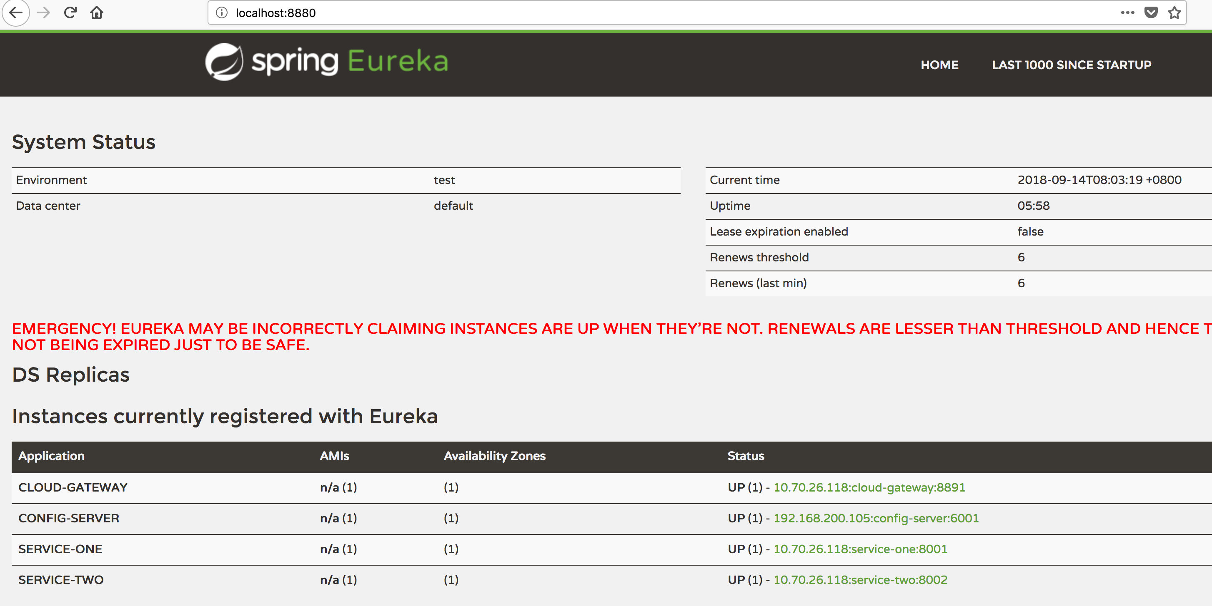
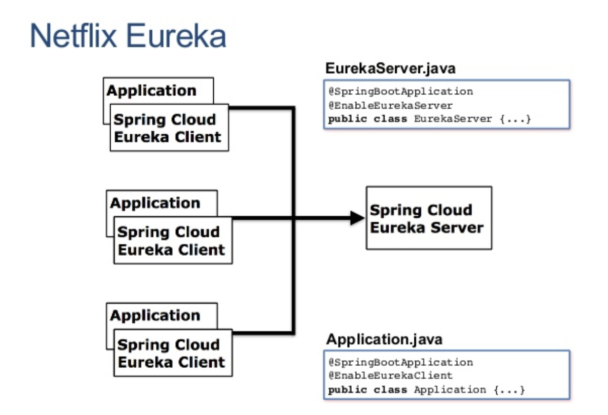
Reg & discovery — Netflix eureka

Slide 8
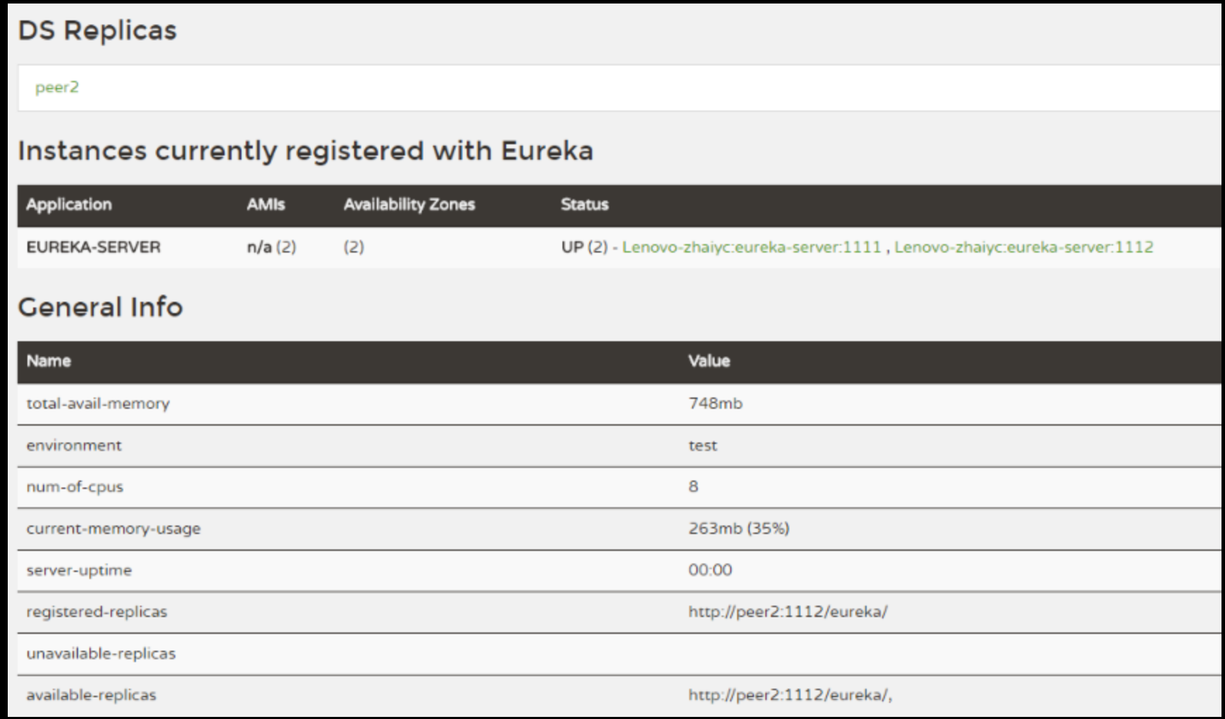
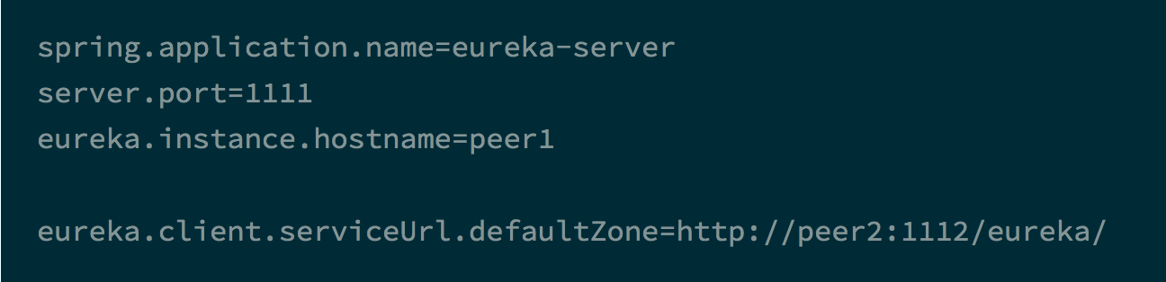
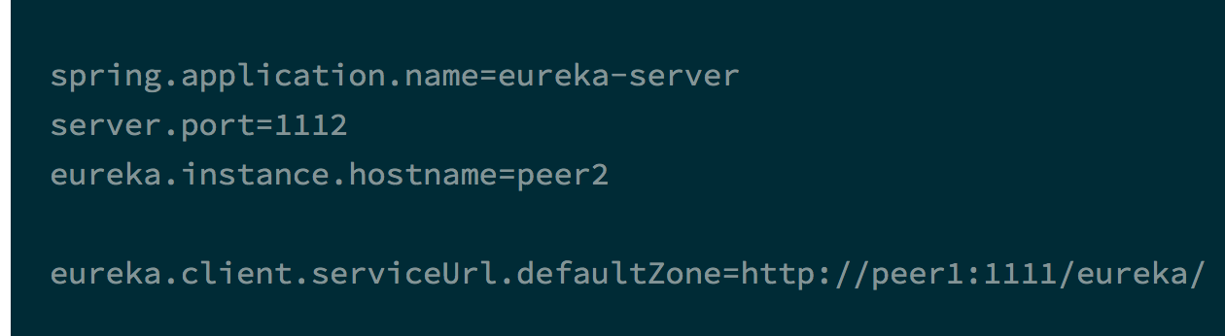
Eureka - ha

Slide 9
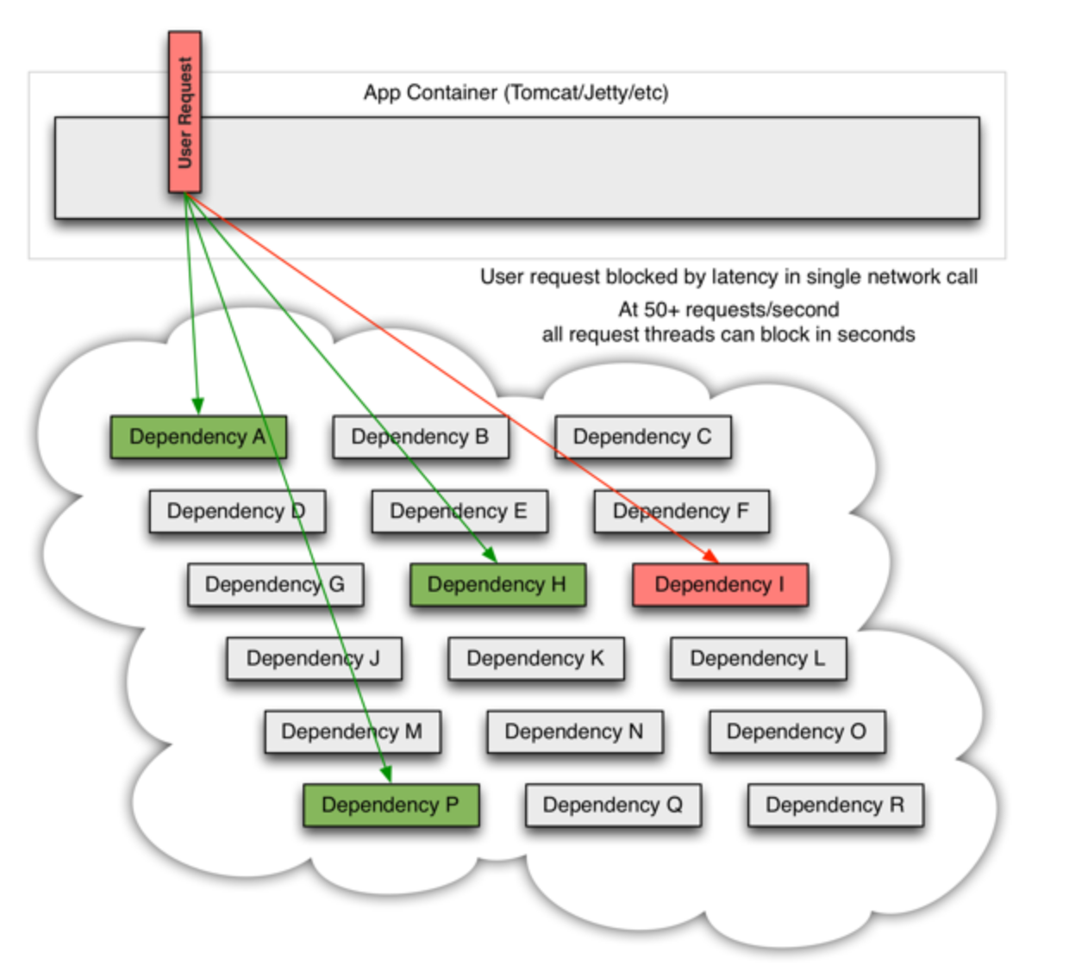
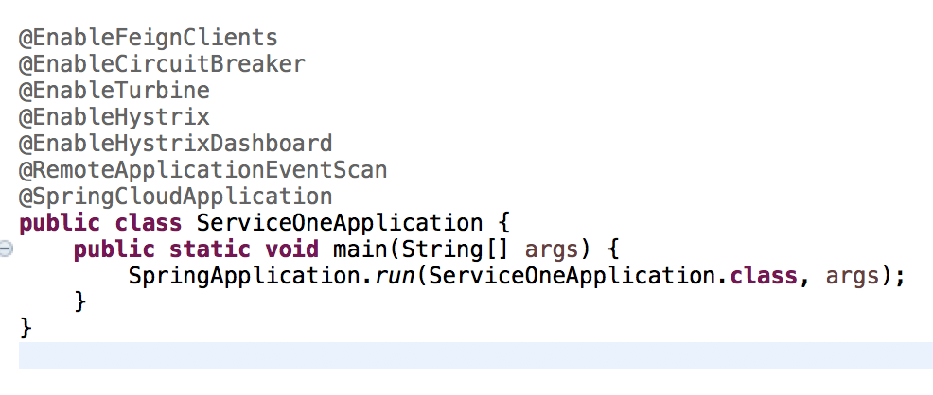
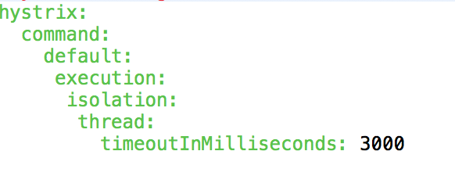
Circuit breaker — hystrix
Isolation | Service downgraded | Circuit breaker | Resilience

Slide 10
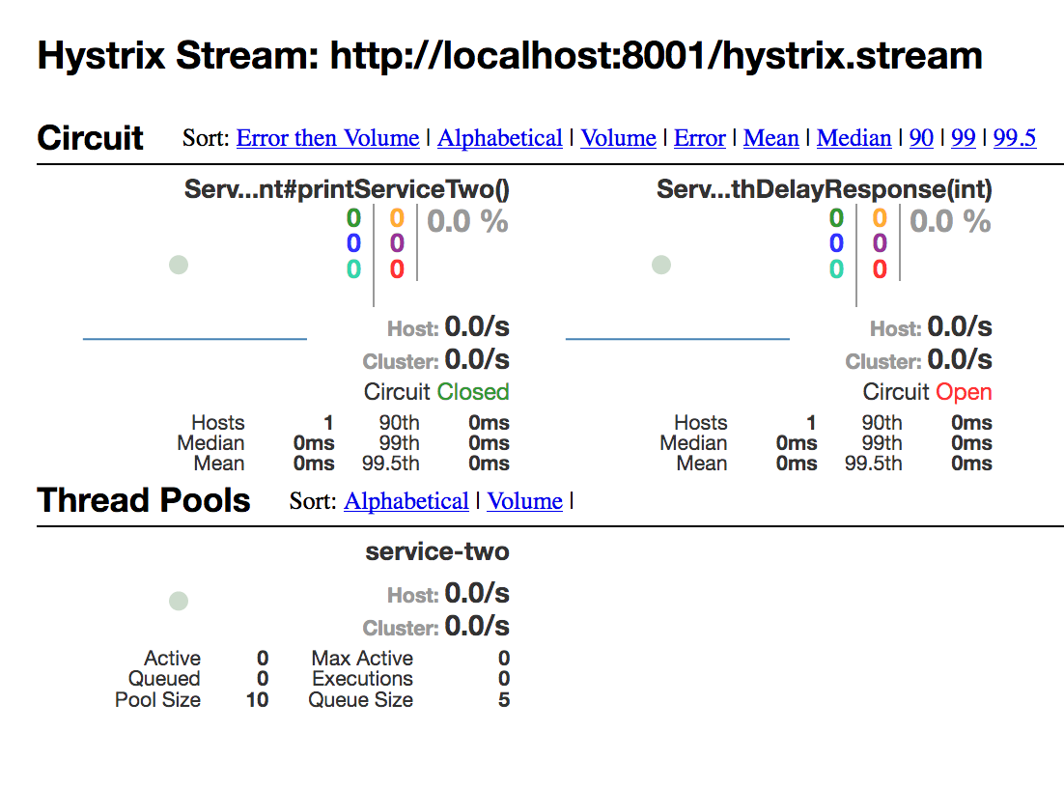
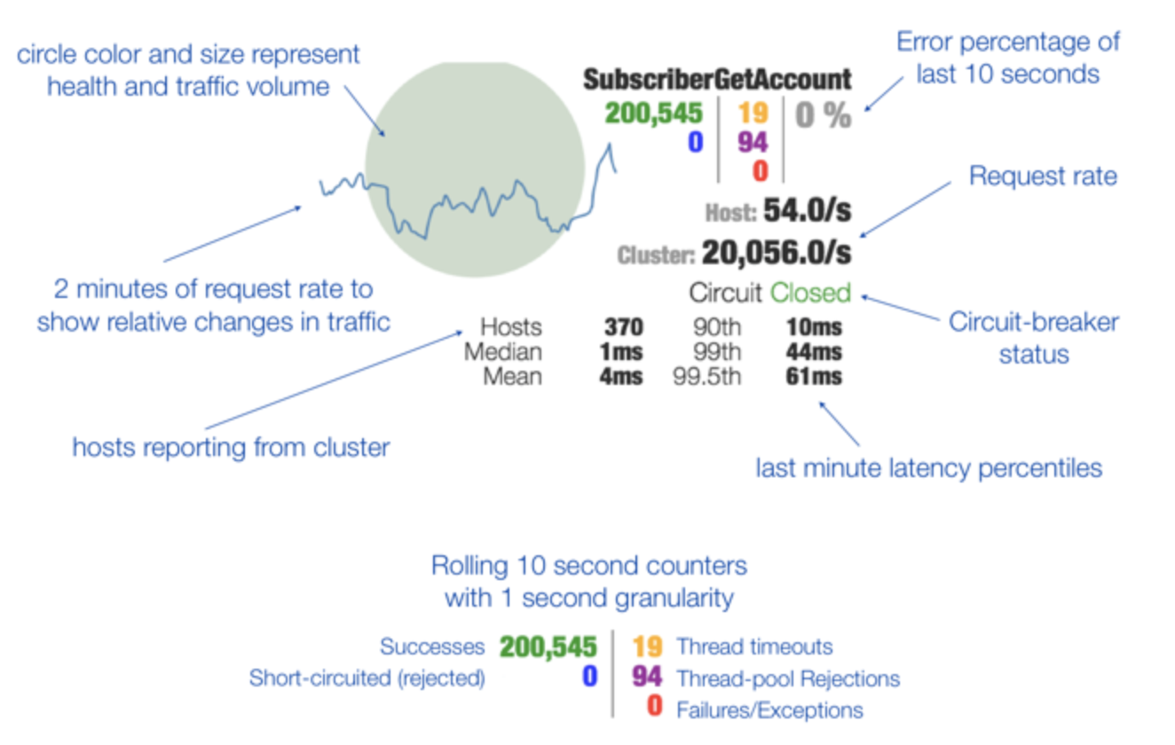
Hystrix monitor
Fallback monitor , hystrix and turbine.

Slide 11
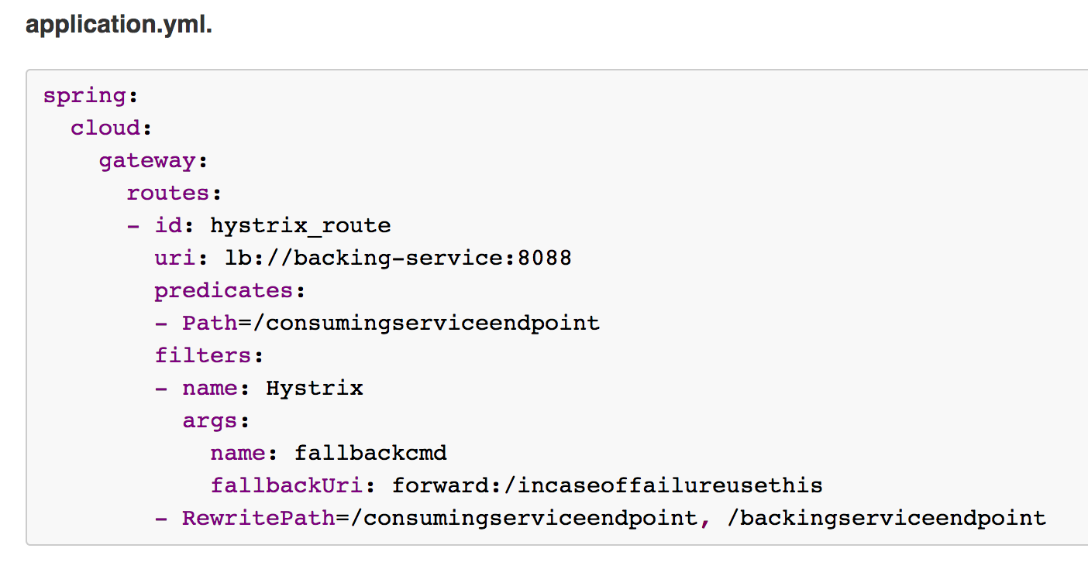
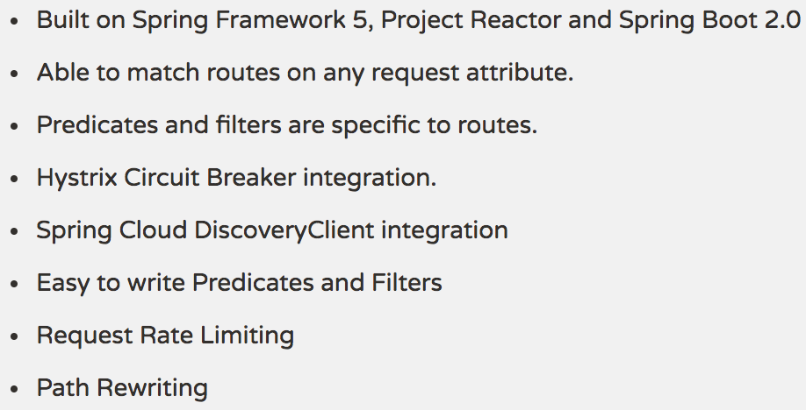
Gate way –spring cloud gateway

Slide 12
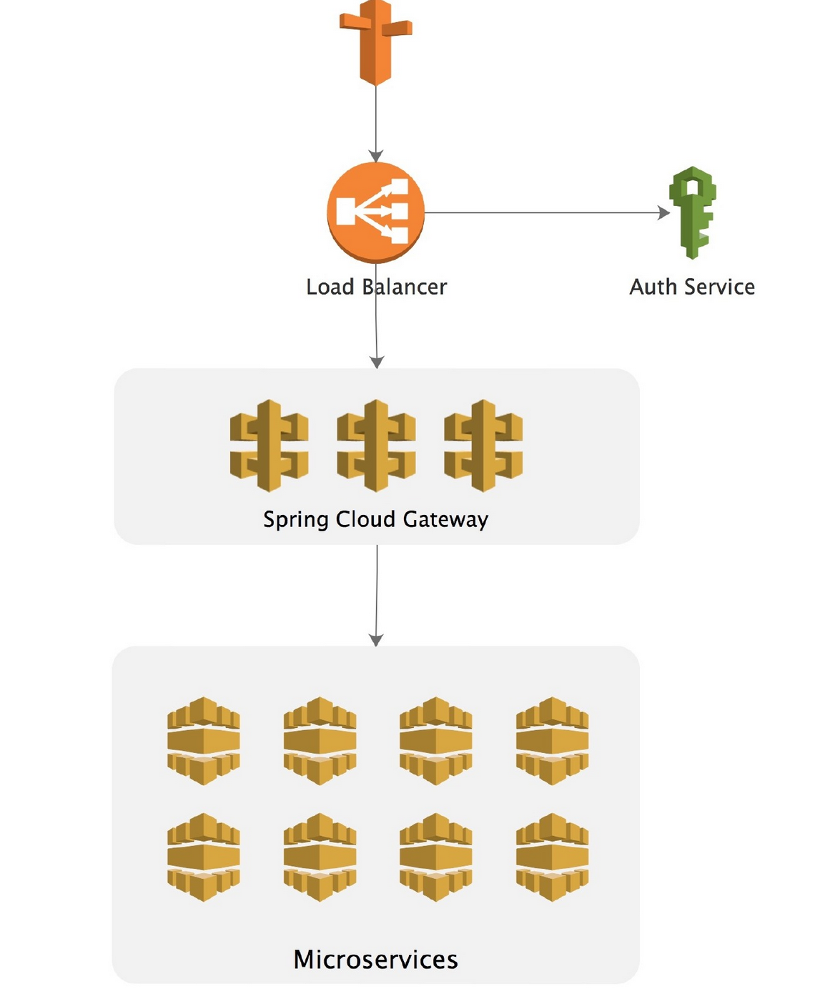
Gateway - ha
Notes:
Start several Gateway instances and put Nginx or F5 for LB in front of gateways.

Slide 13
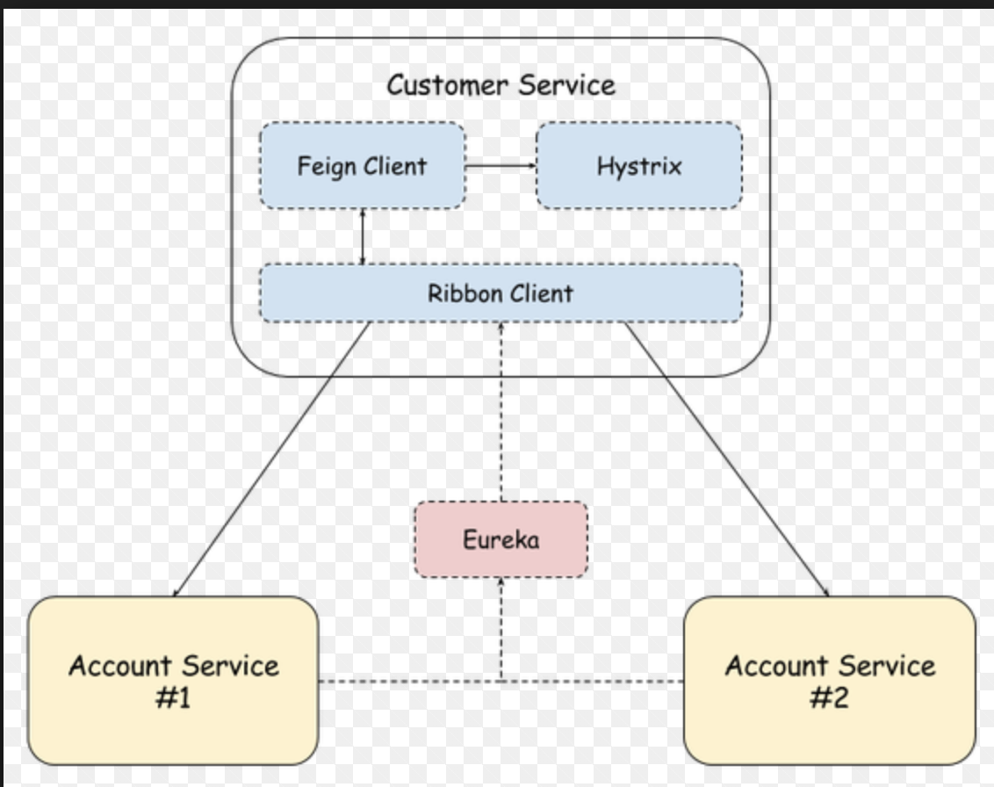
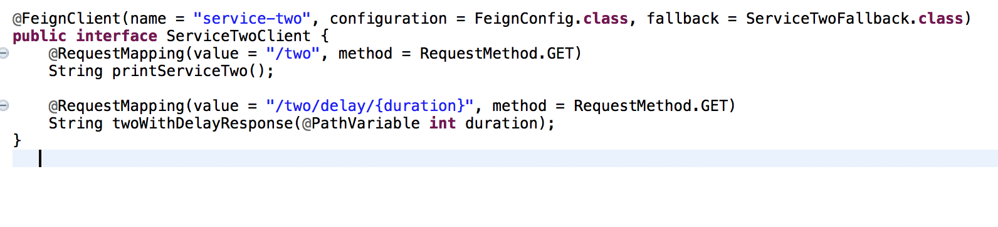
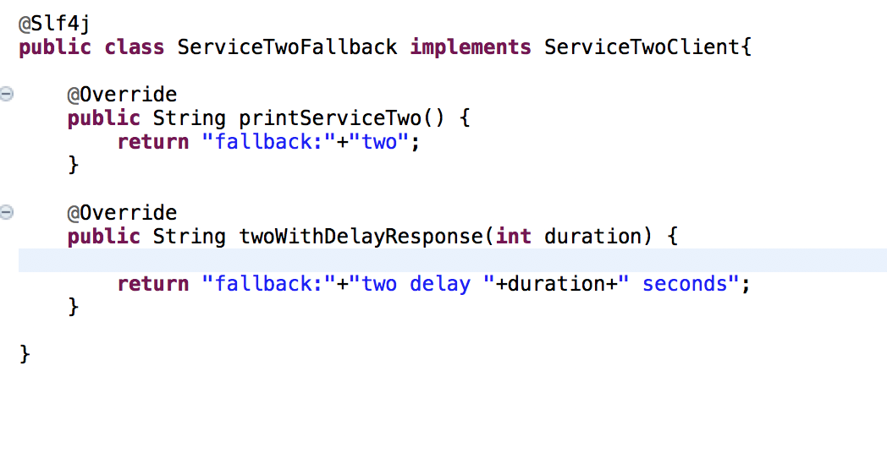
Services communication 1 – feign
Feign is a declarative web service client.

Slide 14
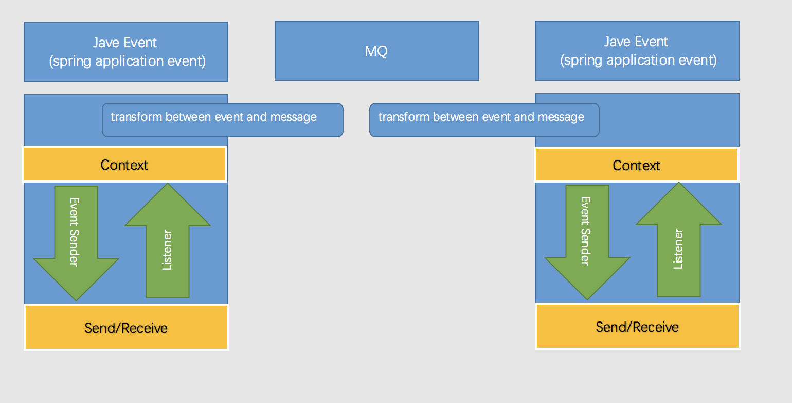
communication2 – spring cloud bus & stream

Slide 15
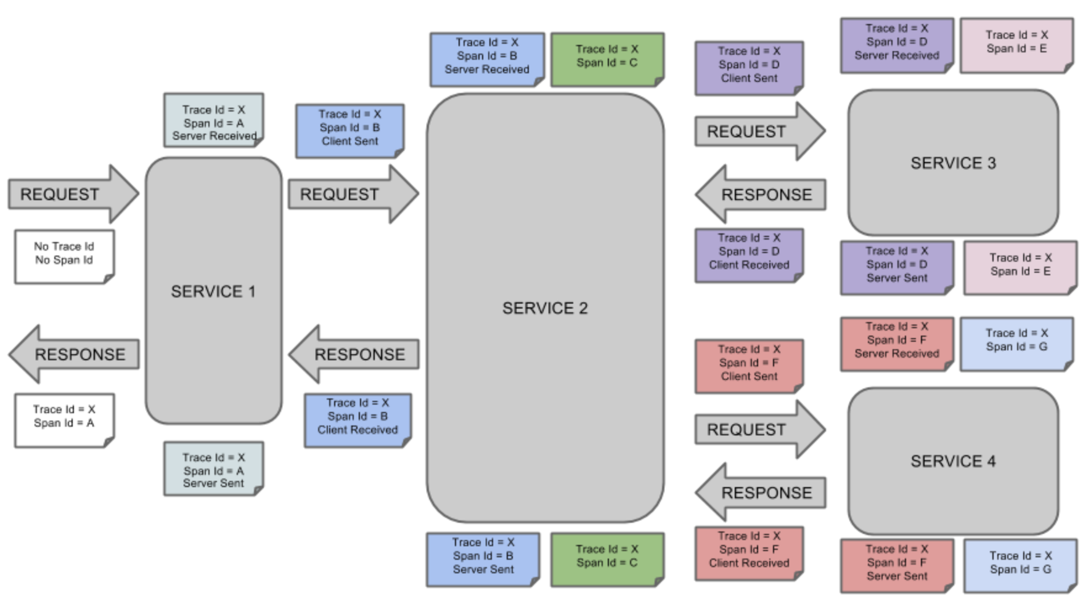
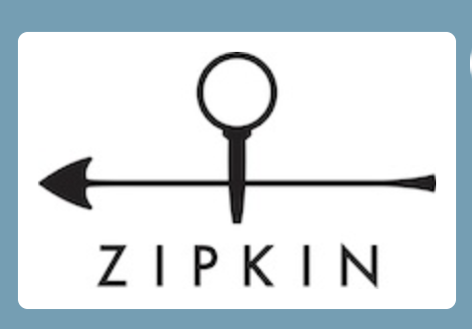

Trace – spring cloud sleuth
Borrow heavily from Dapper [https://research.google.com/archive/papers/dapper-2010-1.pdf]
Trace => Span => Annotation [client send, server received, server send, client received]

Slide 16
summary
Spring Cloud has a rich set of well integrated Java libraries.
Long learning curve and difficult to master every details.
Unified programing model (based on Spring Boot with annotations ).
Spring Cloud alone has a shorter scope in the Micro-services journey. Need other skills to support dev-ops , monitor etc.

Slide 17
Demo
Set up registration center service - Eureka Server.
Setup gateway service – spring cloud gateway.
Services register.
Services call through gateway.
Services communication by Feign.
Circuit break by Hystrix & fallback monitor with Hystrix dashboard.
Config server – spring cloud config.
Message bus - spring-cloud-stream.
demo source code:
https://git.linecorp.com/wang-shuguang/spc-demo.git

Slide 18
~end ~ Thank you .

